Slide 1
Lightweight Deflectometer (LWD) Testing for Subgrade Construction Acceptance: INDOT’s Experience
Peter J. Becker, PhD
Indiana Department of Transportation
Division of Research & Development

Slide 2
Presentation Overview
LWD background
  Performance-based specifications for subgrade construction
  Stiffness-based acceptance testing
  General overview of LWD
  Interpreting LWD test results
LWD use on INDOT contracts
  Initial implementation
  Current specifications
  Future plans

Slide 3
Lightweight Deflectometer (LWD) Background

Slide 4
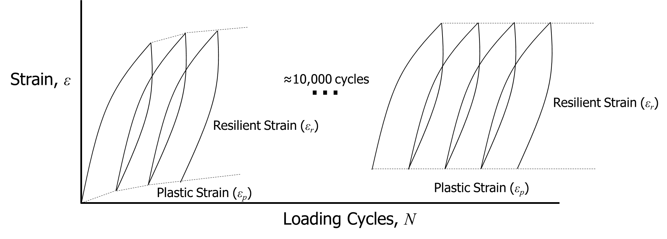


Performance-based Specifications for Subgrade Construction
INDOT has begun implementing performance-based specifications for construction contracts
Performance-based specification definition:
  Quality assurance specification
  Describes desired level of a fundamental engineering property that is a predictor of performance
Resilient modulus (M_{r}) that describes stiffness is the preferred engineering property for pavement design
$$M_{r}=\frac{σ_{d}}{ε_{r}}$$
$$σ_{d}$$

Slide 5
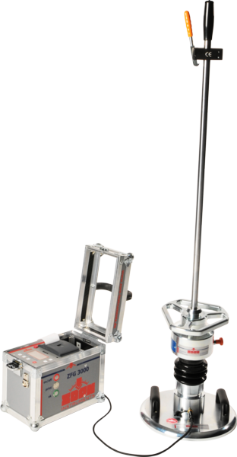
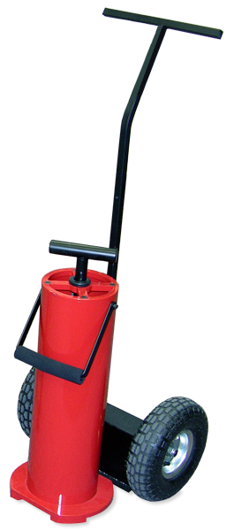
Subgrade Construction Stiffness-based Acceptance Test Methods
Currently used by INDOT for acceptance testing
Light Weight Deflectometer
Clegg Hammer
Credit: Lafayette Instrument Company. (https://lafayetteclegg.com/)
GeoGauge
Credit: Zorn Instruments (https://www.zorn-instruments.com/)
Credit: Humboldt Mfg. Co. (https://www.humboldtmfg.com/)

Slide 6
LWD Main Components
Loading Device
Loading Plate
Guide Rod
Data Collector
Drop Weight
LWD
0.274 mm
Buffer

Slide 7
LWD Operation
(In General)
1. Place loading plate onto ground surface
2. Place loading device onto loading plate
3. Connect data collector to loading plate
4. Lift then release drop weight
  Imparts loading onto loading plate
  Causes loading plate resting on ground surface to deflect vertically
  Amount of deflection depends on stiffness of ground
LWD
5. Record measured deflection of loading plate
  Deflection measured using either accelerometer or geophone
0.274 mm

Slide 8
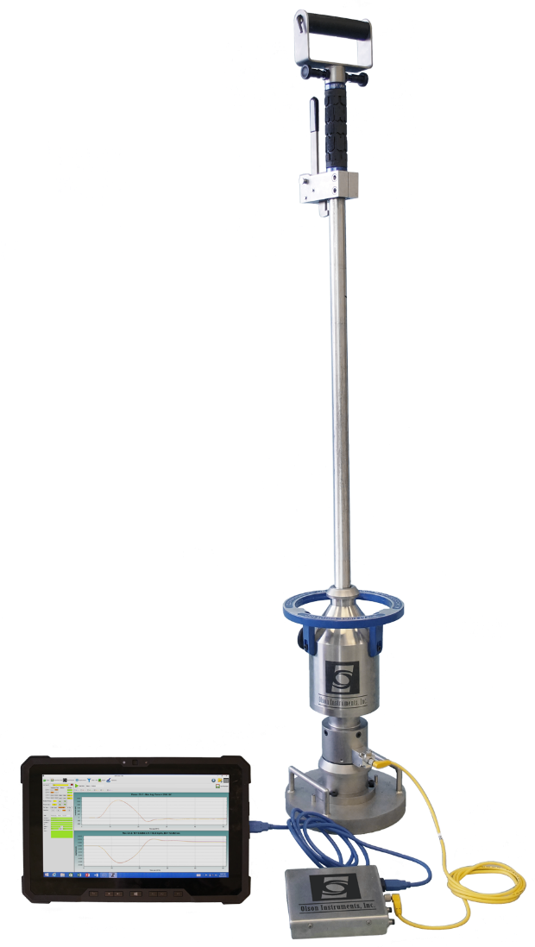
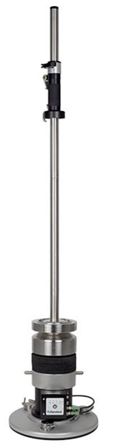
Different LWD manufacturers
Olson Instruments
Zorn Instruments
Dynatest
In accordance with ITM 508
Credit: Olson Instruments (http://www.olsoninstruments.com/)
Credit: Zorn Instruments (https://www.zorn-instruments.com/)
Credit: InstroTek (https://www.instrotek.com/)

Slide 9
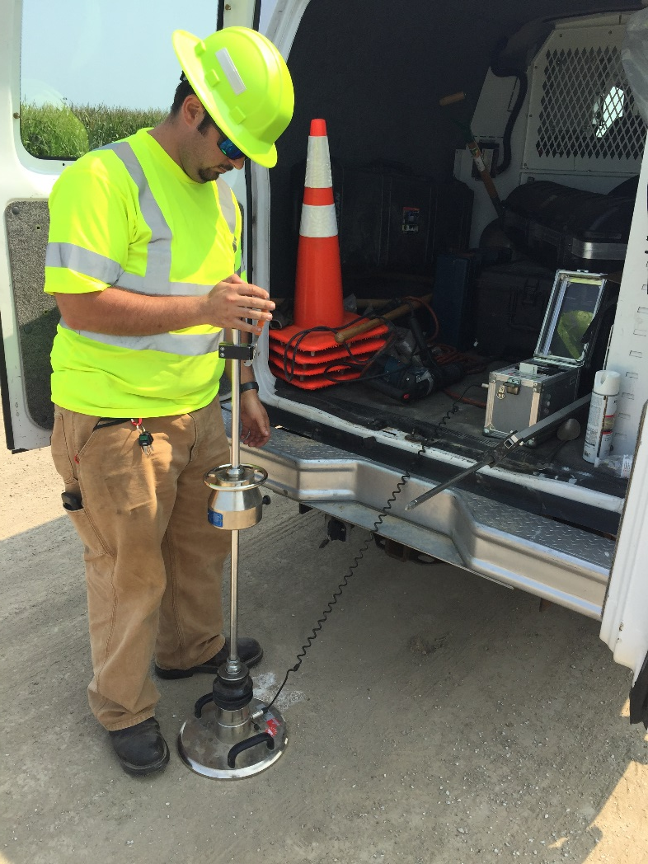
LWD Apparatus in Accordance with ITM 508
Data Collector
Integrates acceleration with respect to time twice to compute deflection
Displays peak deflection in millimeters
10 kg drop weight
Buffer with 354 N/mm spring constant
1,590 lbf peak loading
17 ms pulse duration
Loading plate
(11.81 in. diameter)
14.5 psi maximum applied pressure
≈28-⅜ in. drop height
Accelerometer measuring acceleration with time

Slide 10
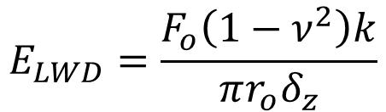






Interpretation of LWD Test Results
Boussinesq’s solution:
In Situ Stresses:
r_{o}
$$σ_{z}=f\left(F_{o},r,z\right)$$
$$σ_{r}=f\left(F_{o},r,z\right)$$
$$σ_{θ}=f\left(F_{o},r,z\right)$$
F_{o}
In Situ Vertical Strain:
r
x
$$ε_{z}=\frac{1}{E}\left[σ_{z}−ν\left(σ_{θ}+σ_{r}\right)\right]$$
y
$$E_{LWD}=\frac{F_{o}\left(1−ν^{2}\right)k}{πr_{o}δ_{z}}$$
x
z
ν is Poisson’s ratio
(0.2 to 0.4 typical)
σ_{z}
τ_{zr}
E is elastic Modulus
F_{o} is applied force
r_{o} is loading plate radius
ν is Poisson’s ratio
k is applied stress shape factor
δ_{z} is surface deflection
y
Vertical Deflection at Surface:
σ_{θ}
τ_{rz}
σ_{r}
$$δ_{z}=\int_{0}^{∞}{ε_{z}dz}$$
z
$$δ_{z}=\frac{F_{o}\left(1−ν^{2}\right)k}{πr_{o}E}$$
k is applied stress shape factor

Slide 11
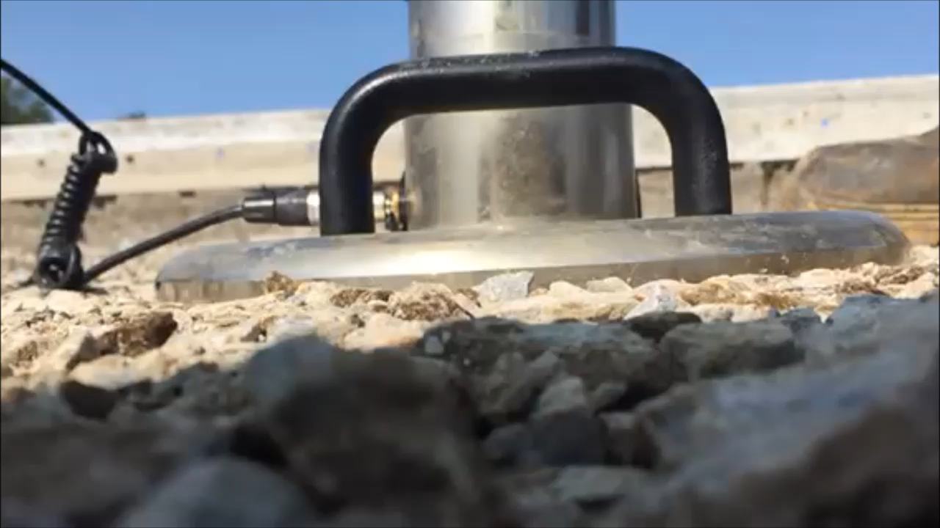
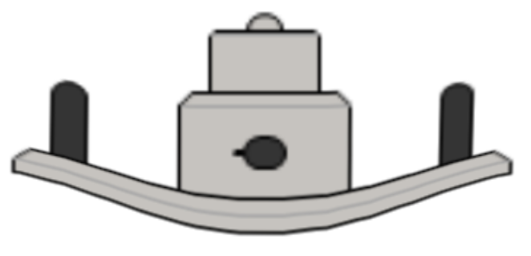
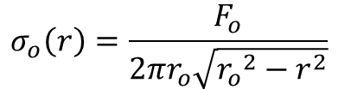

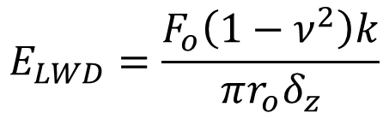




Applied Stress Shape Factor (k)
Uniform Stress Distribution
$$σ_{o}$$
$$k=2$$
δ_{z}
≈0.4δ_{z}
$$E_{LWD}=\frac{F_{o}\left(1−ν^{2}\right)k}{πr_{o}δ_{z}}$$
Inverse-Parabolic Stress Distribution
$$σ_{o}\left(r\right)=\frac{F_{o}}{2πr_{o}\sqrt{{r_{o}}^{2}−r^{2}}}$$
$$k=\frac{π}{2}$$
Better Assumption
$$σ_{o}\left(r\right)$$
$$k=\frac{π}{2}$$

Slide 12
LWD Elastic Modulus

Slide 13





LWD Measurement Influence Depth (MID)
$$σ_{o}=f\left(z\right)$$
$$∆σ=10 psi$$
LWD
$$r_{o}=0.98 ft$$
Layered strata
$$MID≈2r_{o}$$
$$≈2r_{o}$$
White, D. J., Becker, P., Vennapusa, P. K. R., Dunn, M. J., & White, C. I. (2012). Assessing Soil Stiffness of Stabilized Pavement Foundations. Transportation Research Record, 2335, 99 – 109.

Slide 14
Lightweight Deflectometer Implementation on INDOT Contracts

Slide 15
Initial LWD Implementation
LWD for acceptance testing became standard specification for 2016 contracts
  Intended only for compaction of aggregates (No. 53, No. 73, and Structure Backfill Sizes 1”, 1¹/₂”, and 2”)

Slide 16
Initial Implementation Required Site Specific Deflection Criteria
Determining Deflection Criteria from Test Pad (ITM 514):
Place aggregate in a 100’ x 20’ area
Compact aggregate with smooth drum vibratory roller (4 passes in vibratory mode, 1 pass in static mode)
Conduct 10 LWD tests across test pad area; determine average deflection
Recompact aggregate with one vibratory roller pass followed by one static roller pass
Conduct 10 LWD tests at same locations as in Step 3; determine average deflection
If there is no change in average deflection, then aggregate is fully compacted; otherwise repeat steps 4 and 5
Maximum deflection for the rest of the contract is the average deflection when the test pad aggregate is fully compacted

Slide 17
LWD Testing Frequency
One series of LWD tests per 800 tons of aggregate
  LWD test series comprises 3 LWD tests
    2 ft from left edge of construction area
    At middle of construction area
    2 ft from right edge of construction area
One Moisture content test per day
  If deflection is too high and aggregate is wet, wait 24 hours for water to drain

Slide 18
Current LWD Use at INDOT
With release of the 2018 Standard Specifications, LWD for acceptance testing now applies to subgrade chemical modification in addition to aggregate compaction
Subgrade Treatment Type IB
203.24(b)
14”
4% to 5% Cement or Lime
One LWD test series per 1,400 CY of modified soil

Slide 19
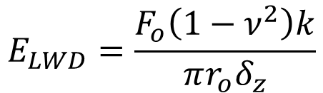
Why 0.27 mm and 0.30 mm Deflections?
MEPDG Resilient Modulus Inputs
  Cement modified subgrade resilient modulus typically equals 14,500 psi
  Lime modified subgrade resilient modulus typically equals 13,000 psi
Assuming M_{r} ≈ E_{LWD}
  Cement modified subgrade LWD deflection should equal ≈0.27 mm
  Lime modified subgrade LWD deflection should equal ≈0.30 mm
$$E_{LWD}=\frac{F_{o}\left(1−ν^{2}\right)k}{πr_{o}δ_{z}}$$
F_{o} = 1,589 lbf
ν = 0.30
k = 2
r_{o} = 5.91 in.

Slide 20
INDOT Intends to Eliminate LWD Test Pads Altogether
SPR-4100
Trial LWD Deflection Criteria implemented for contracts during 2019
 | Equipment Access Constraints | Target Average LWD Deflection
6 in. No. 53 Aggregate over untreated soil | None | 0.51 mm
 | Rollers prohibited | 0.60 mm
12 in. No. 53 Aggregate over untreated soil | None | 0.34 mm
 | Rollers prohibited | 0.47 mm

Slide 21
Future of Lightweight Deflectometer (LWD) at INDOT

Slide 22

INDOT Is Improving the LWD Deflection Criteria for Chemically Modified Subgrades (SPR-4230)
Goal of SPR-4230:
Specified chemically modified subgrade resilient modulus used in design
Confirm specified chemically modified subgrade resilient modulus during construction
In situ quality assurance testing
Light weight deflectometer (LWD)
Rapid
Easy to use
Provides stiffness measurement

Slide 23
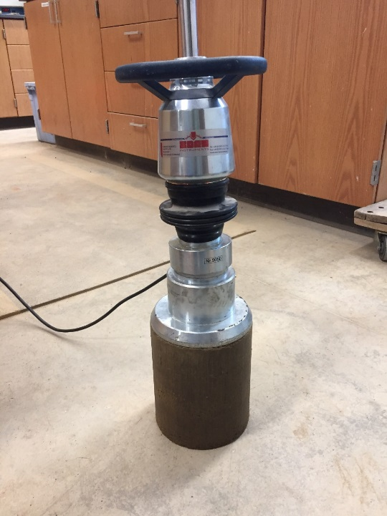


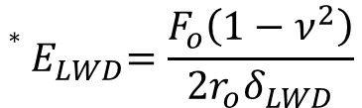

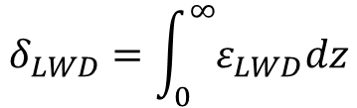
Expected outcomes for SPR-4230
Develop empirical model for LWD elastic modulus from applied stress
Predict in situ LWD elastic using empirical model
$$E_{LWD}=ae^{bσ_{a}}$$
$$E_{LWD}=ae^{b\left(σ_{z}−2νσ_{r}\right)}$$
$$ε_{LWD}=\frac{1}{E_{LWD}}\left[σ_{z}−ν\left(σ_{r}{+σ}_{θ}\right)\right]$$
$$δ_{LWD}=\int_{0}^{∞}{ε_{LWD}dz}$$
$${∗E}_{LWD}=\frac{F_{o}\left(1−ν^{2}\right)}{2r_{o}δ_{LWD}}$$

Slide 24
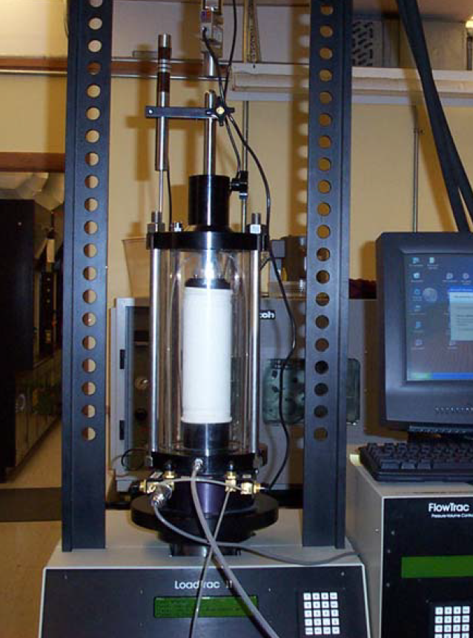
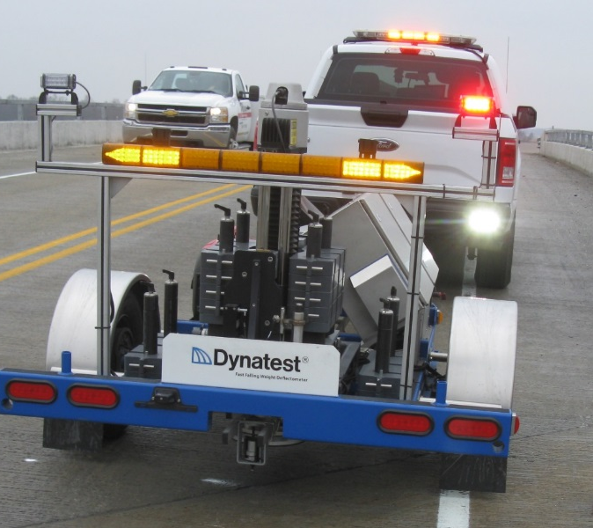
Expected outcomes for SPR-4230
Correlate LWD elastic modulus with resilient modulus
Confirm LWD elastic and resilient modulus correlation from FWD testing
Publish findings as Purdue University Joint Transportation Research Program (JTRP) technical report in 2020

Slide 25
Thank you for your attention

